Slide 1
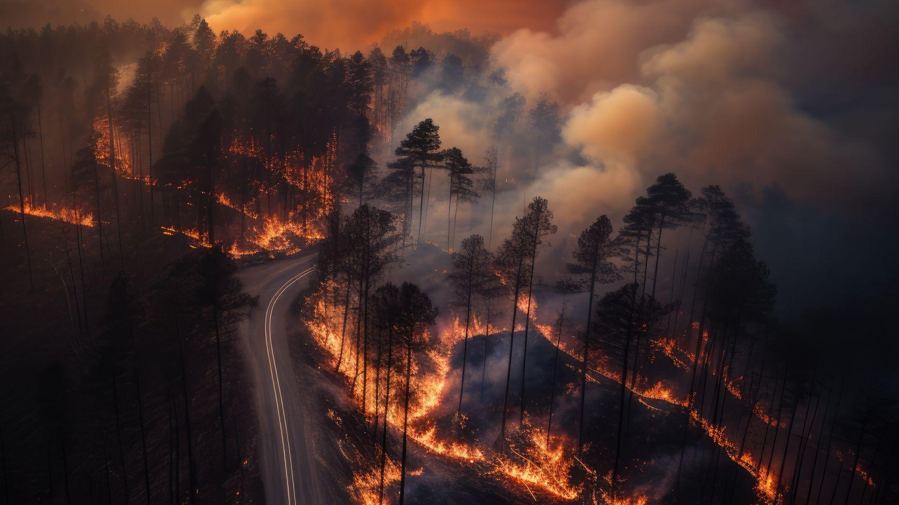
Non-parametric Analysis of the Forest Fires Data
Instructor : Dr. Sharmishtha Mitra
Submitted by : Group 12(Parvez-241080082, Piyush Kumar-241080083, Prottush Das-241080085, Riya Sharma-241080088, Sahil Kumar Kalsaria-241080091)

Slide 2
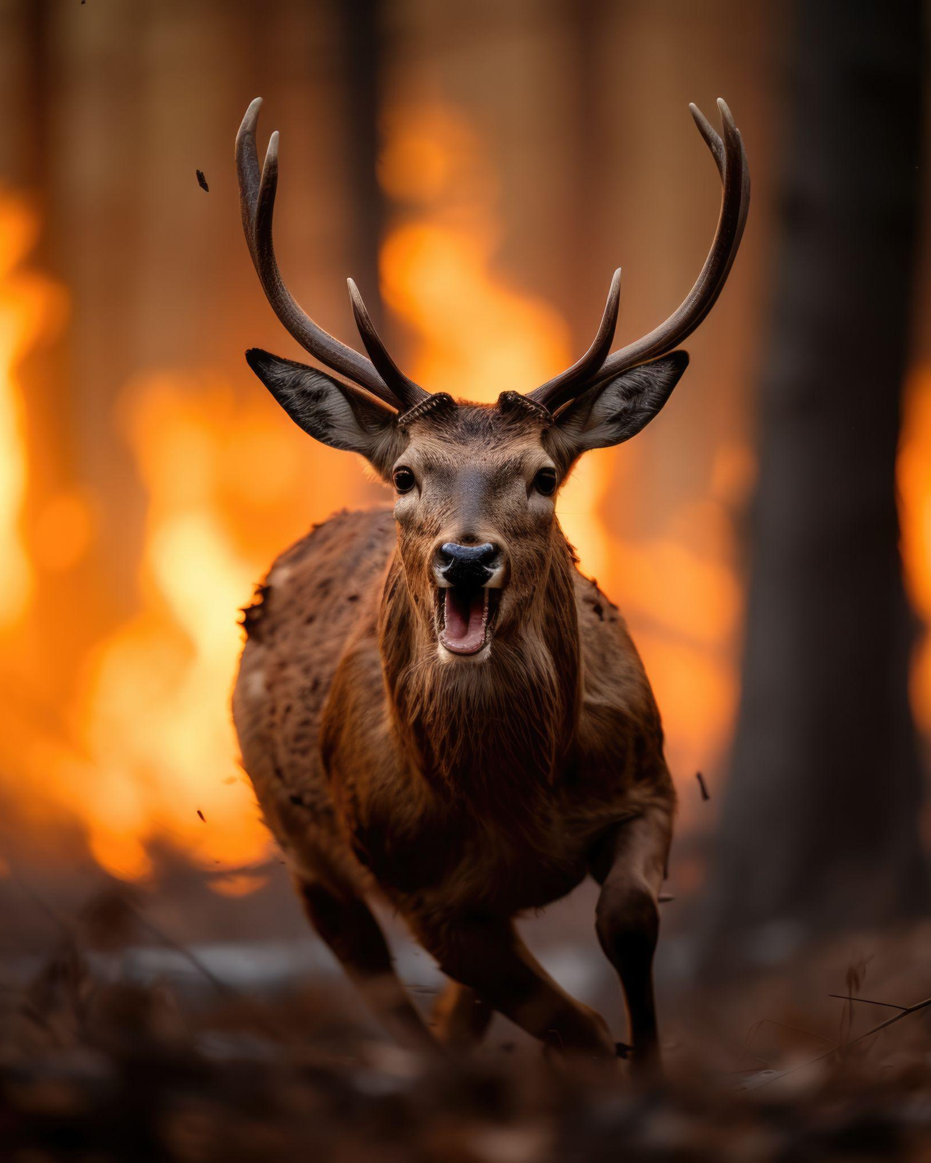
01
02
03
04
05
06
TABLE OF CONTENTS
07
INTRODUCTION
STUDY OVERVIEW & APPROACH
DATA OVERVIEW & SUMMARY
ONE-SAMPLE NON-PARAMETRIC TESTS
TWO-SAMPLE NON-PARAMETRIC TESTS
CONCLUSION & Key Findings
KEY IMPLICATIONS

Slide 3
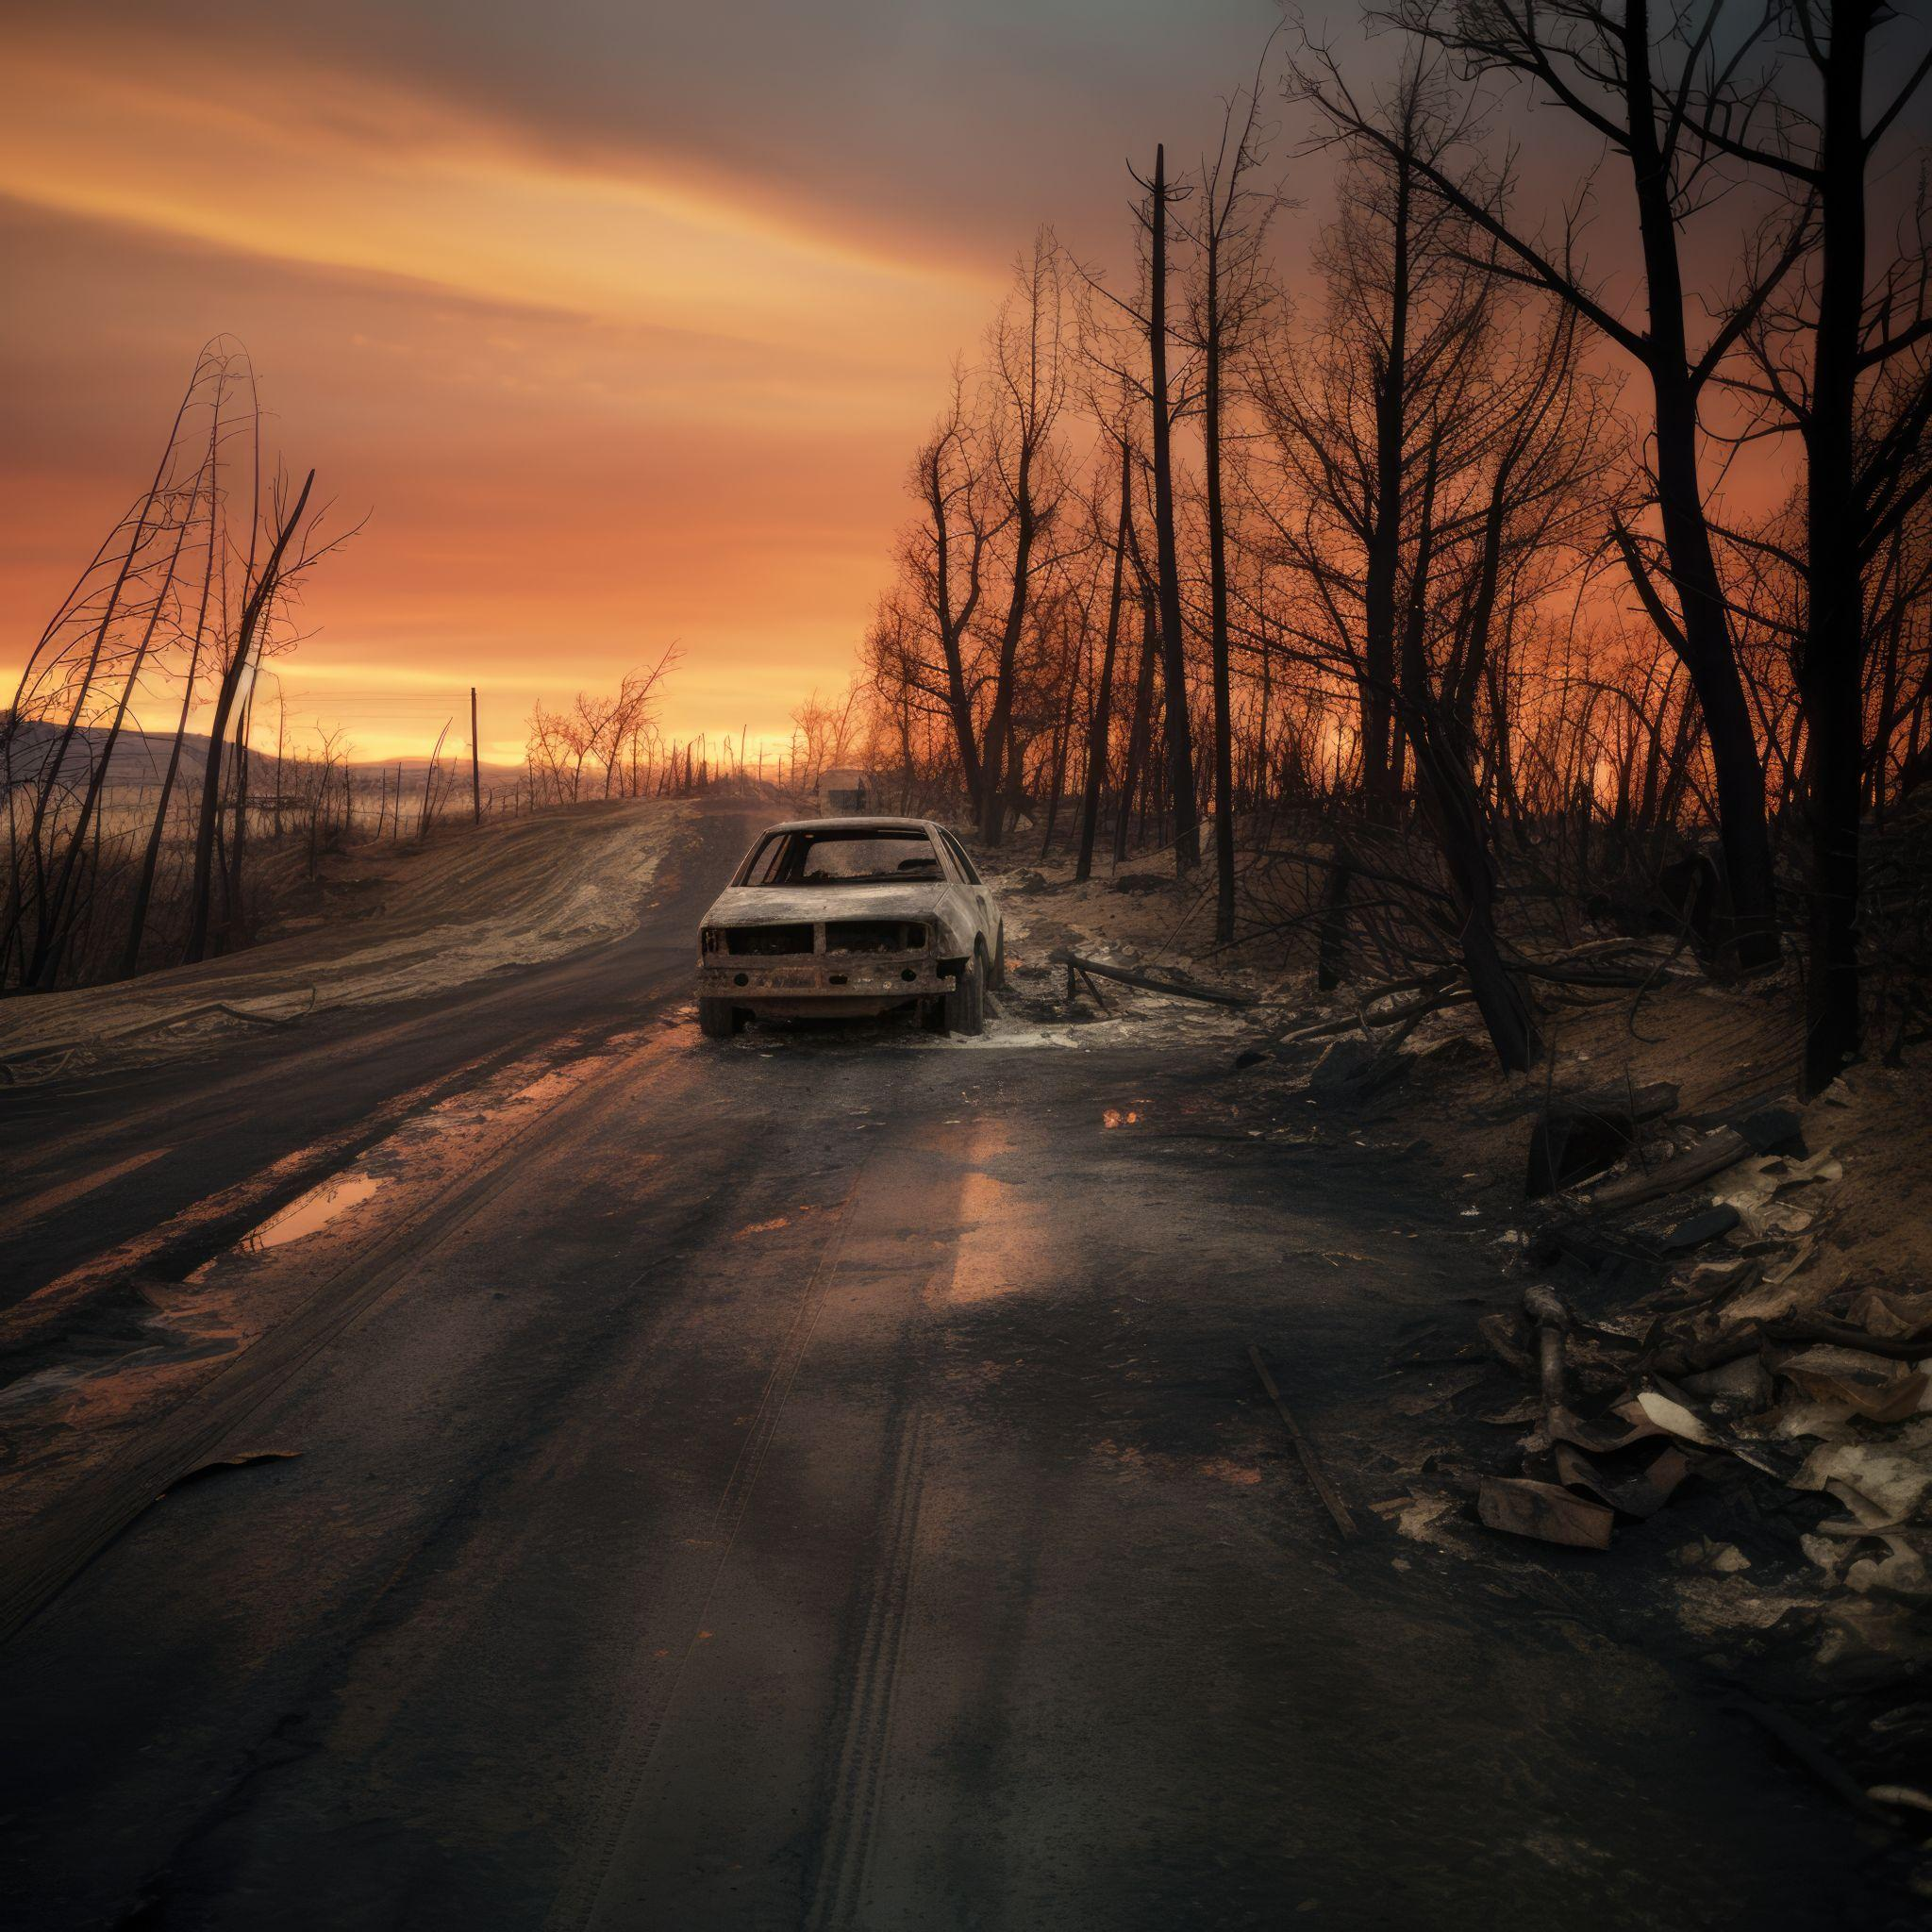
Introduction
Forest fires cause severe environmental, economic, and social damage worldwide.
Predicting the extent of burned areas is vital for:
  Efficient resource allocation in fire management.
  Developing preventive and mitigation strategies.
Accurate prediction supports sustainable environmental planning and risk reduction.

Slide 4
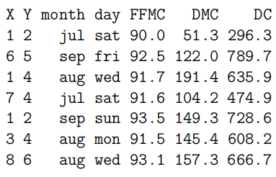
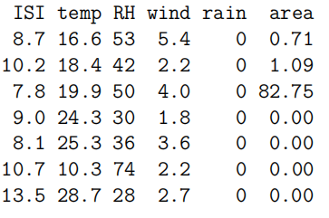
Study Overview and Approach
Dataset: Forest Fires dataset (Cortez & Morais, 2007, UCI Repository)
  517 fire instances
  13 variables:
    Spatial: X, Y
    Temporal: month, day
    Fire Weather Index (FWI) components: FFMC, DMC, DC, ISI
    Meteorological: temp, RH, wind, rain
    Target: burned area (area)
  Challenge: Burned area distribution is highly skewed, violating normality assumptions.
  Solution: Use non-parametric statistical methods and rank-based analyses for robust inference.
  Preliminary Insights:
    Significant links between FWI components, temperature, wind, and burned area.
  Outcome: Demonstrates the value of spatial, temporal, and meteorological data in predictive fire modeling.

Slide 5
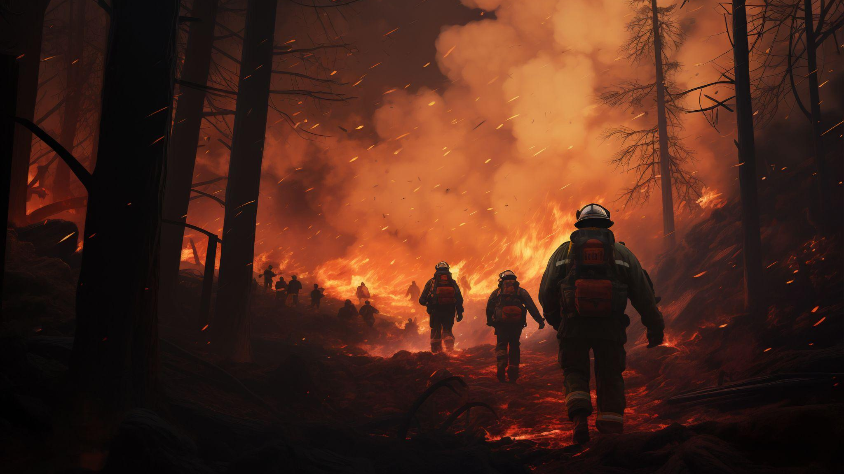
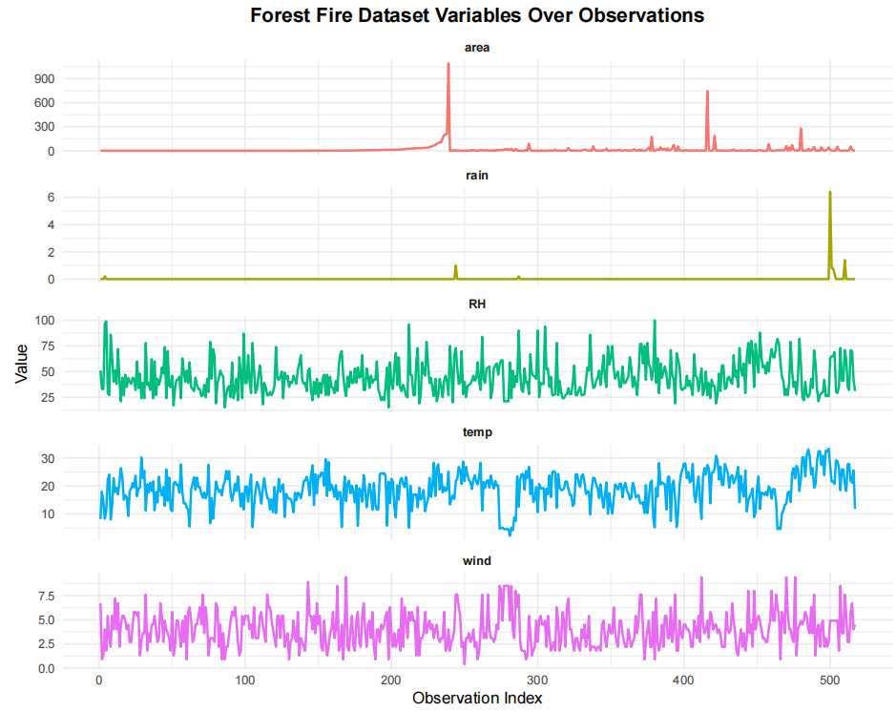
Data Overview & Summary
Dataset includes:
  Categorical variables: month, day (capture temporal patterns)
  Continuous variables: FFMC, DMC, DC, ISI, temp, RH, wind, rain, area (represent fire indices, weather, and fire severity)
Understanding variable distributions helps reveal patterns and relationships.
Time-series visualization shows how meteorological factors and burned area evolve over time — highlighting trends, seasonality, and outliers
Two monthly subsets created for focused analysis:
  August data and September data (critical fire months)
  Enables detection of month-specific patterns possibly hidden in full dataset.
Created a binary “fire occurrence” variable (fire vs. no-fire days), which supports two-sample non-parametric tests to compare conditions.

Slide 6
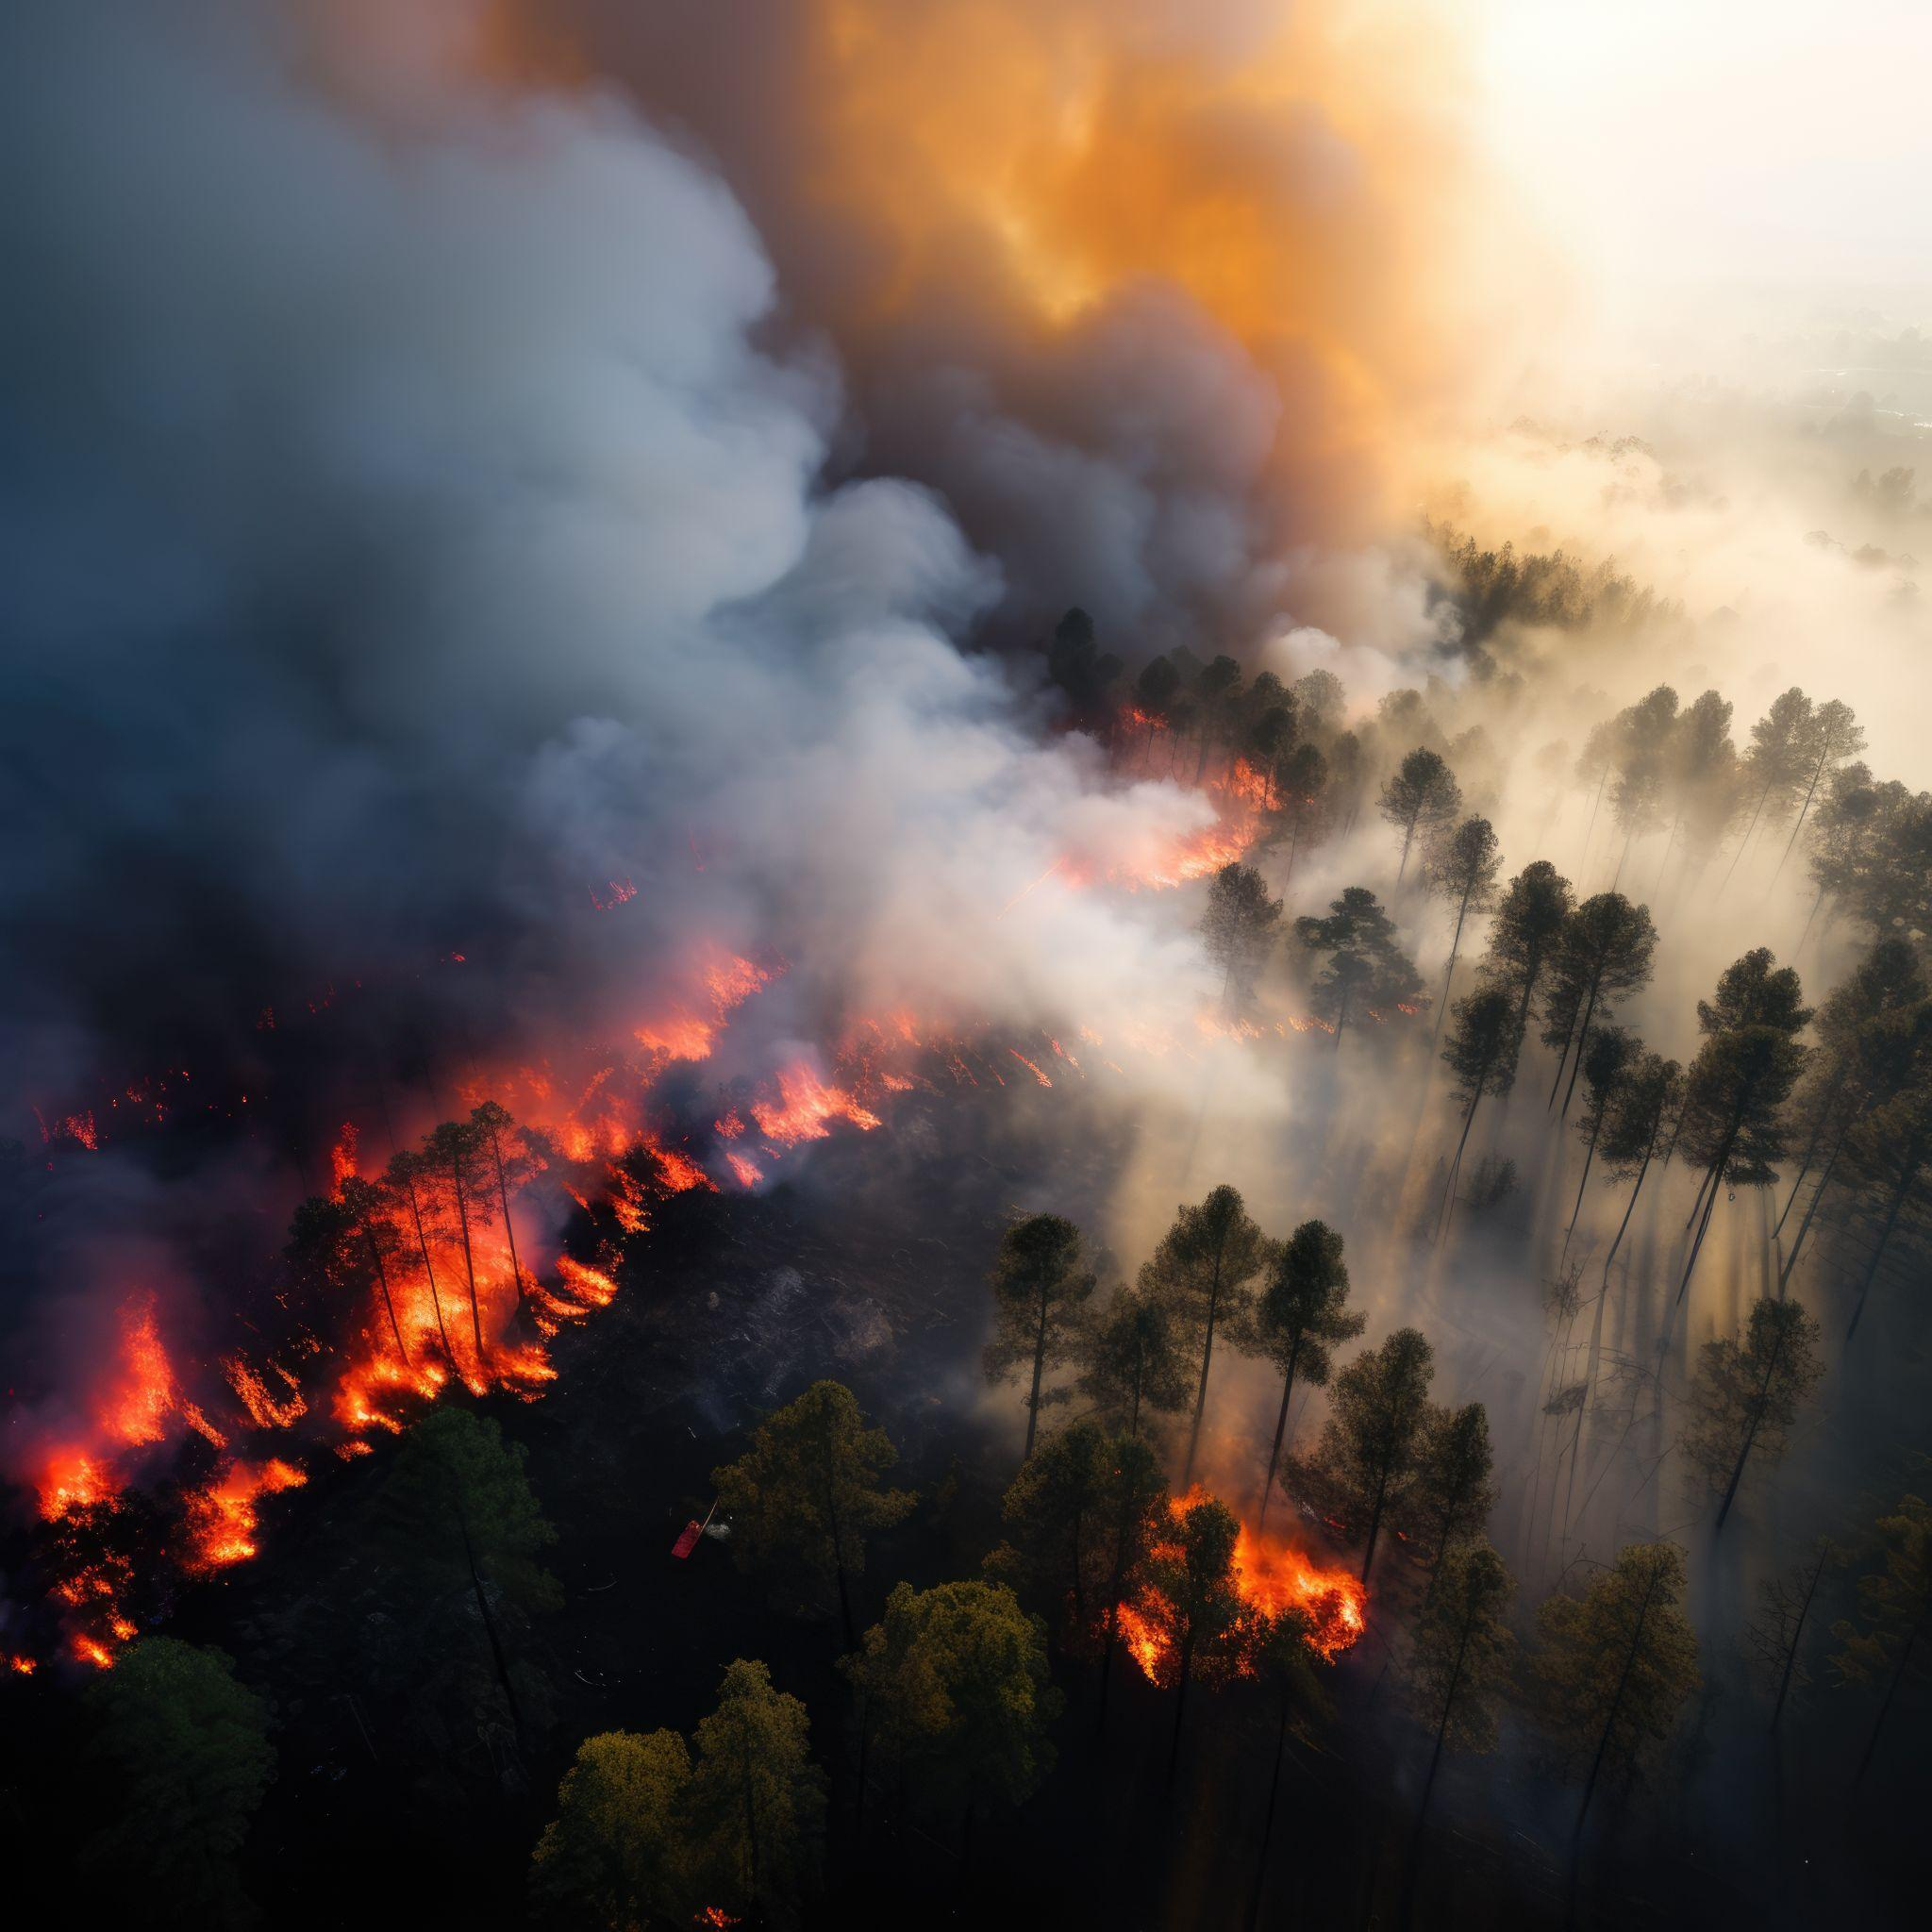
One Sample Non-Parametric Tests
Runs Test for Randomness
Chi-Square Goodness-of-fit Test
Kolmogorov-Smirnov Test

Slide 7
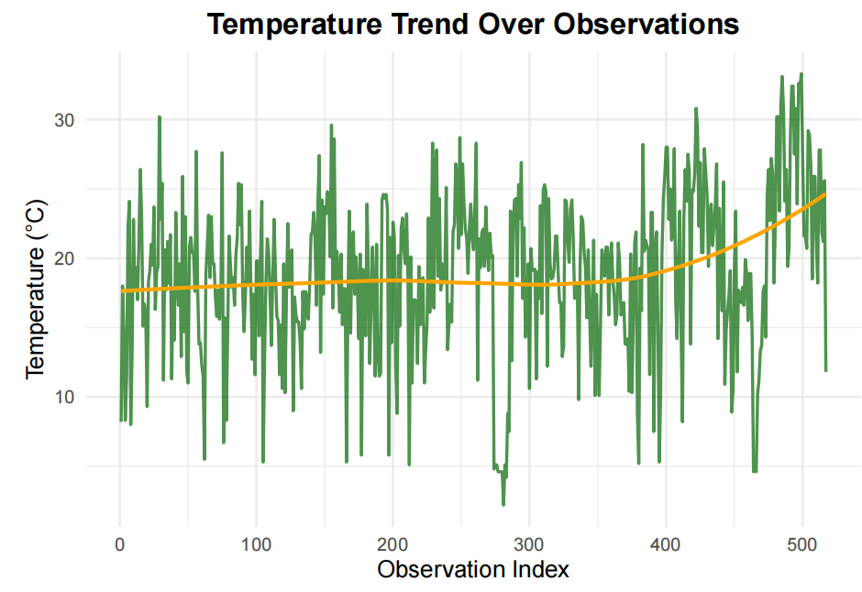
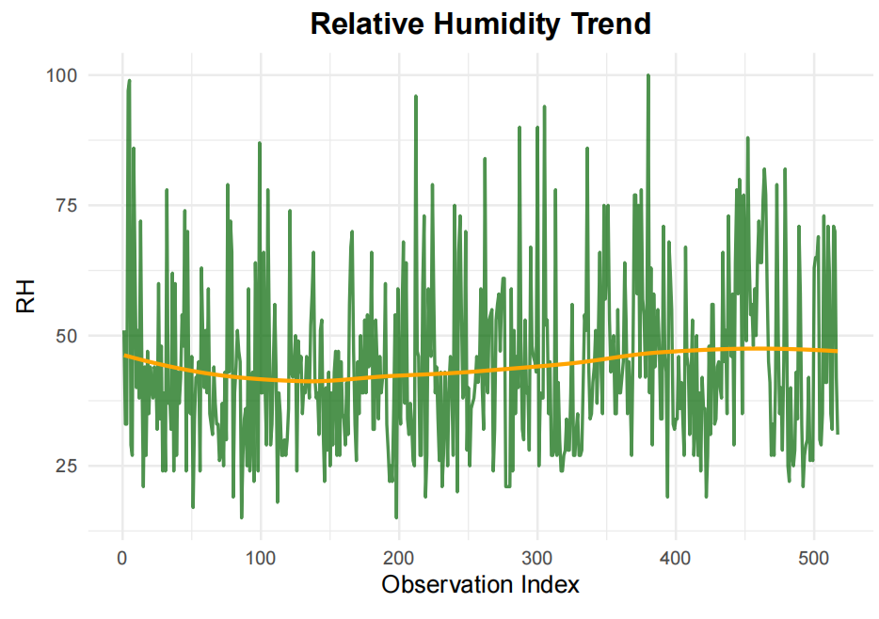
Runs Test
Objective: To assess whether observations of key variables occur randomly over time
Variables tested: Temperature, Relative Humidity, Wind Speed, Rain Occurance, Burned Area.
Hypotheses (generalized):
  H₀: Observations (high and low values) occur in a random sequence
  H₁: Observations (high and low values) occur in a non-random pattern
p-value (Temperrature)= 1.66e-09, p-value(RH) = 0.004124, p-value(wind) = 0.007003, p-value(area) < 2.2e-16 and p-value(rain) < 2.2e-16
Conclusion : We can see that in all the cases p-value<<0.05, thus we may reject H₀ and conclude that observation occur in non-random pattern.
Weather phenomena are inherently persistent. For e.g. a day with high wind speed is often followed by another high-wind day until the weather system changes.

Slide 8
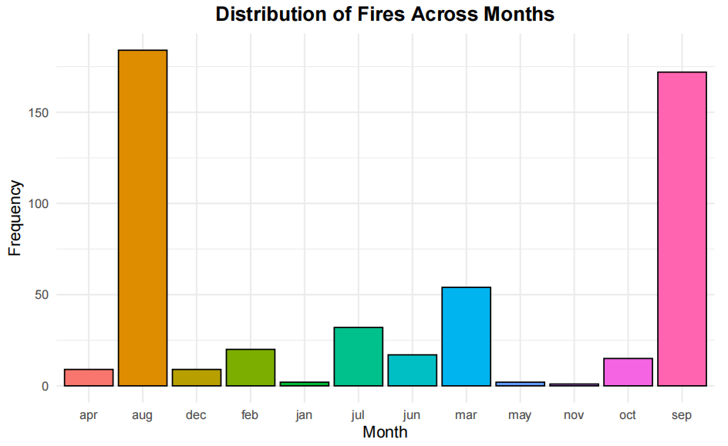
Chi-Sq GoF Test
Objective: To assess whether categorical data follow a specified theoretical distribution.
Hypotheses:
  H₀: Forest fires are uniformly distributed across months.
  H₁: Forest fires are not uniformly distributed across months
Conclusion: Fire frequency varies significantly by month (p < 0.001), revealing strong seasonal patterns with peak fire activity concentrated in specific months(which are August and September).

Slide 9
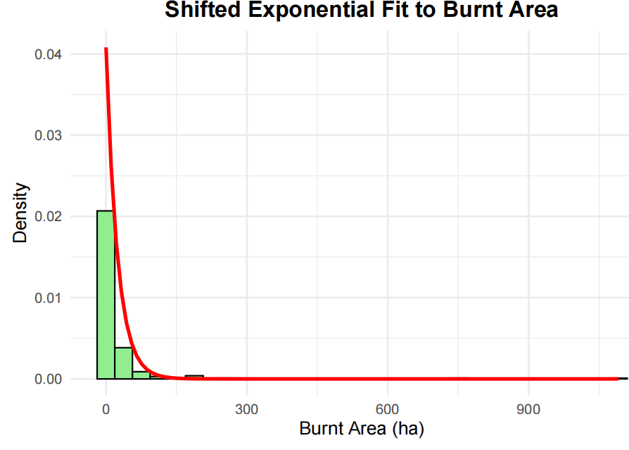
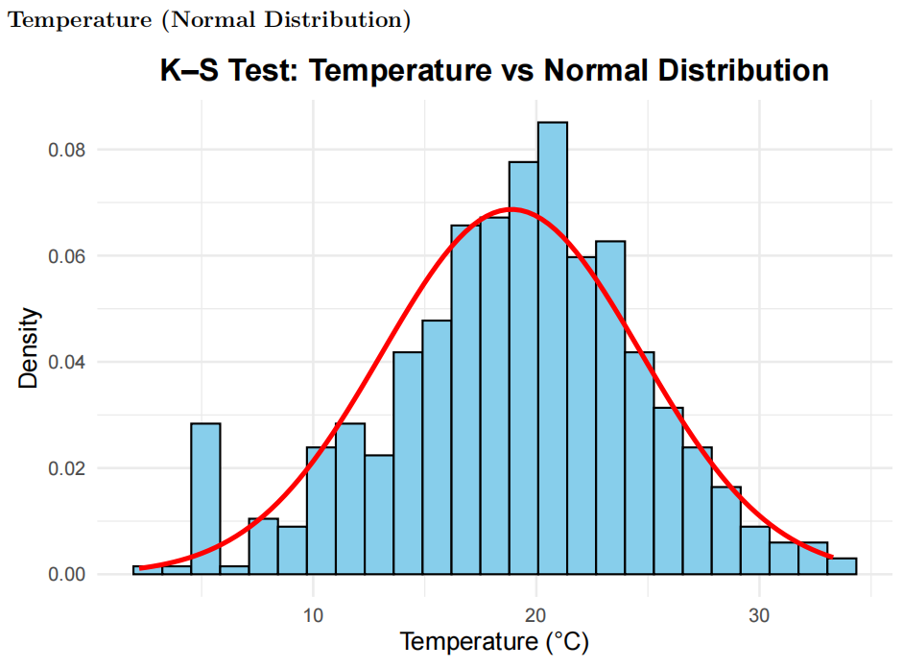
Kolmogorov-Smirnov Test
Objective: To compare the empirical distribution of a variable to a theoretical distribution (e.g., normal, exponential, Gumbel) and evaluate whether the observed data could plausibly come from that distribution.
Hypothesis:
  H₀: The burnt area follows a shifted exponential distribution
  H₁: The burnt area does not follow a shifted exponential distribution
Conclusion: Burned area does not follow a shifted exponential distribution(p-value < 2.2e-16).
Hypothesis:
  H₀: Temperature follows a normal distribution.
  H₁: Temperature does not follow a normal distribution.
Conclusion: Temperature is consistent with normal distribution (p = 0.139)

Slide 10
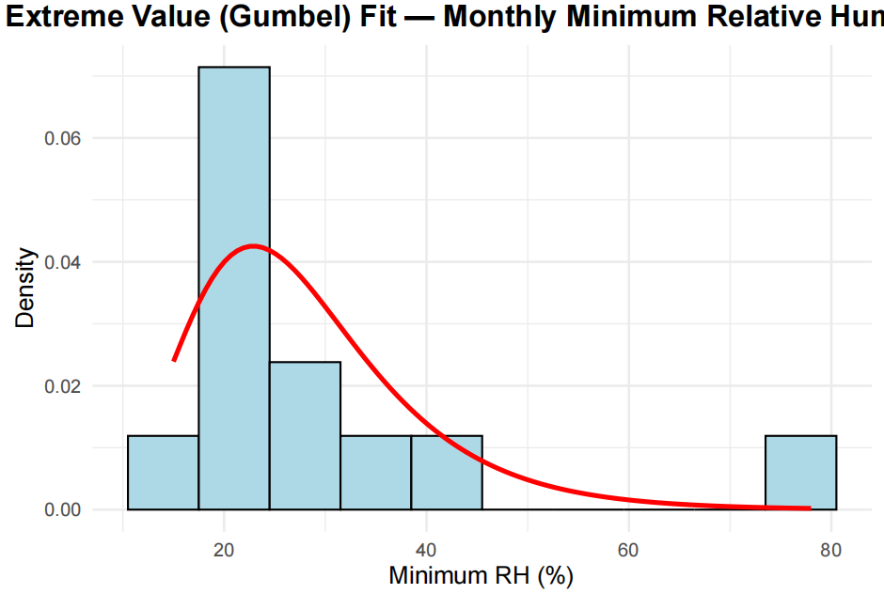
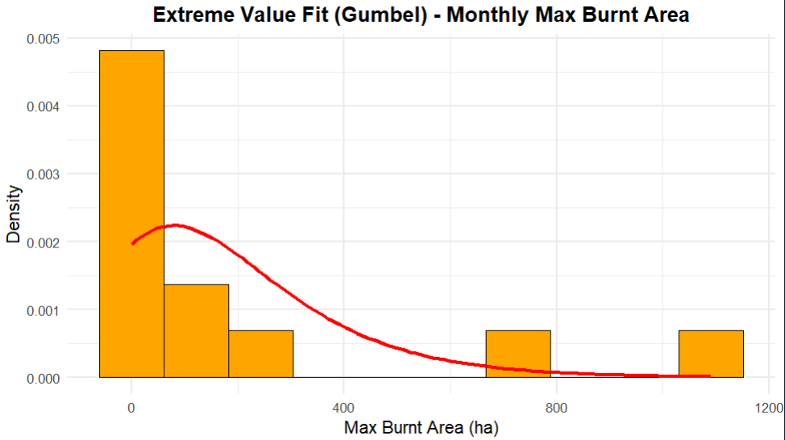

Kolmogorov-Smirnov Test
The Gumbel distribution is an extreme value distribution used to model the distribution of the maximum (or minimum) of a dataset — commonly applied in meteorology and hydrology to analyze extreme events like floods, rainfall, or temperature peaks.
$$f(x:μ,σ) = \frac{1}{σ}exp[−(\frac{x−μ}{σ}) − exp(−\frac{x−μ}{σ})], −∞<x<∞$$
$;−∞<μ<∞, σ>0$
Hypothesis:
  H₀: Minimum RH values follow a Gumbel distribution.
  H₁: Minimum RH values do not follow a Gumbel distribution
Conclusion: Monthly minimum RH follows Gumbel distribution (p = 0.596), appropriate for extreme value analysis.
Hypothesis:
  H₀: Maximum burnt areas follow a Gumbel distribution
  H₁: Maximum burnt areas do not follow a Gumbel distribution
Conclusion: Monthly maximum burned area marginally rejects Gumbel fit (p = 0.043)

Slide 11
Two-Sample Non-Parametric Tests
Wilcoxon Rank-Sum Test
Mood’s Test
Kolmogorov-Smirnov Test
Spearman Correlation Test
Kruskal-Wallis Test

Slide 12
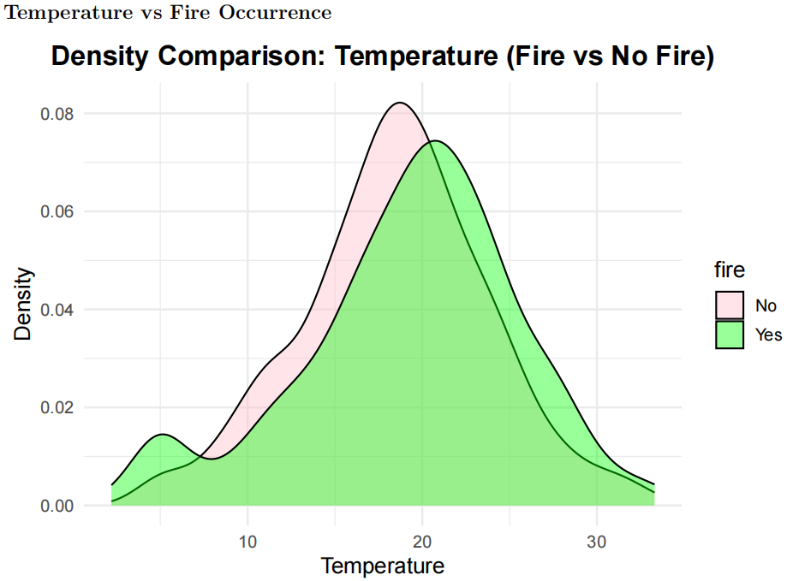
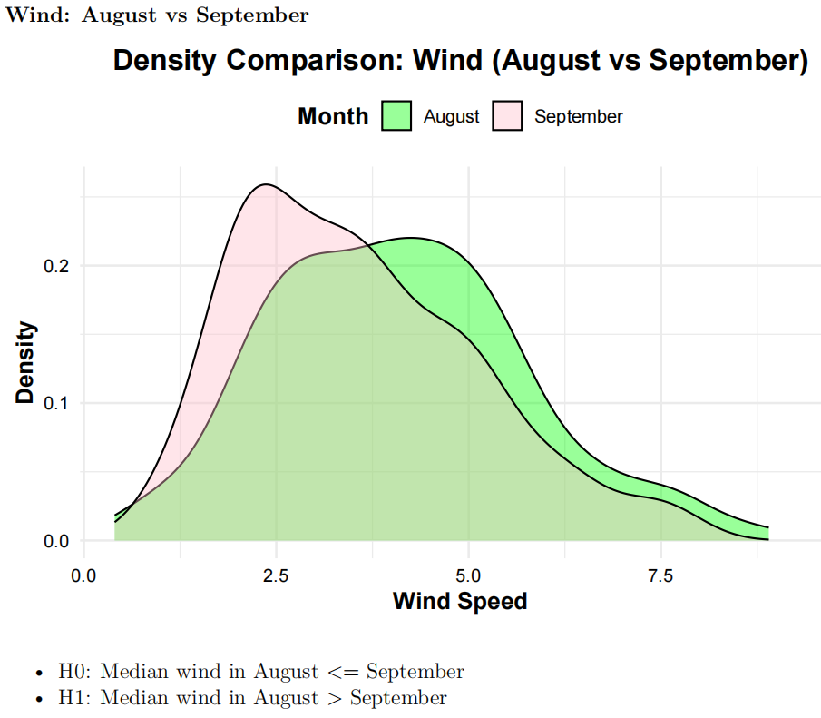
Wilcoxon Rank-Sum Test
Objective: To tests whether the median values of two groups differ, without assuming normality. A significant result indicates differences in median weather conditions, revealing which variables drive fire likelihood and intensity
Hypothesis:
  H₀: Median temperature is equal for days with and without burned area
  H₁: Median temperature is higher on days with burned area
Conclusion: Days with burned area have significantly higher median temperatures (p = 0.007), confirming temperature’s role in fire risk.
Hypothesis:
  H₀: Median wind in August <= September
  H₁: Median wind in August > September
Conclusion: August has stronger winds (p < 0.001), increasing fire spread potential despite lower drought.

Slide 13
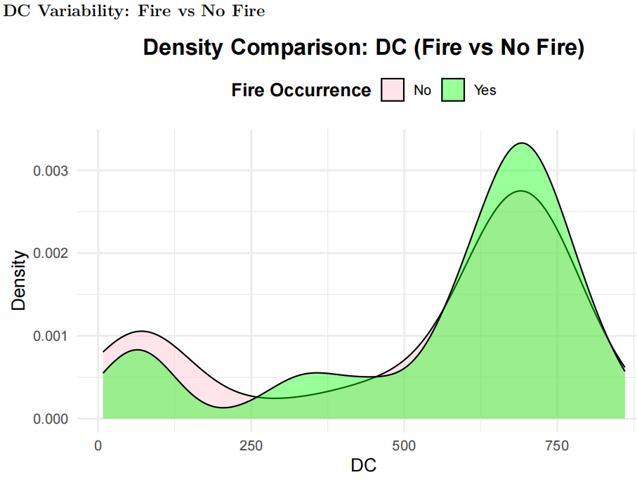
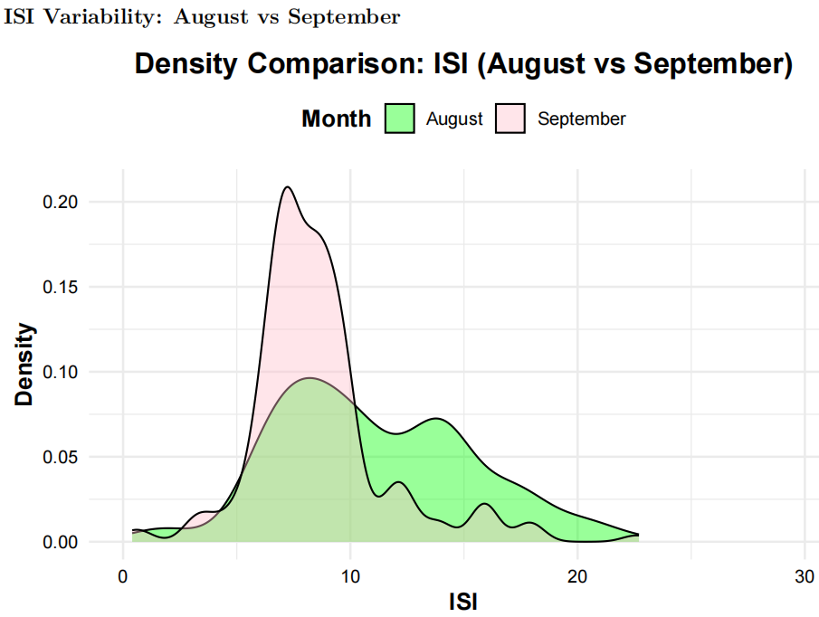
Mood’s Test
Objective: To examine whether two samples differ in variance (dispersion) rather than location. To test if the variability of one variable is significantly greater or smaller across two groups. In the forest fire dataset, it’s used to check whether the variability of indices (like DC, FFMC, ISI) changes between:
  Fire vs No-Fire days, or
  August vs September
Hypothesis:
  H₀: Variance of DC (Fire) >= Variance of DC (No Fire)
  H₁: Variance of DC (Fire) < Variance of DC (No Fire)
Conclusion: DC variability is similar regardless of fire occurrence (p = 0.345); drought level matters more than variability.
Hypothesis:
  H₀: Variance of ISI (August) <= Variance of ISI (September)
  H₁: Variance of ISI (August) > Variance of ISI (September)
Conclusion: ISI exhibits higher variability in August (p = 0.001), indicating erratic fire spread potential.

Slide 14
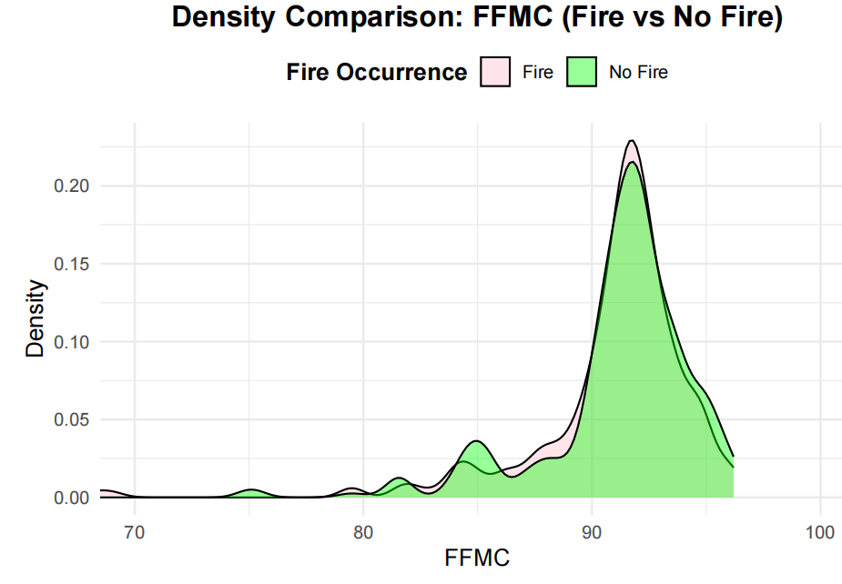
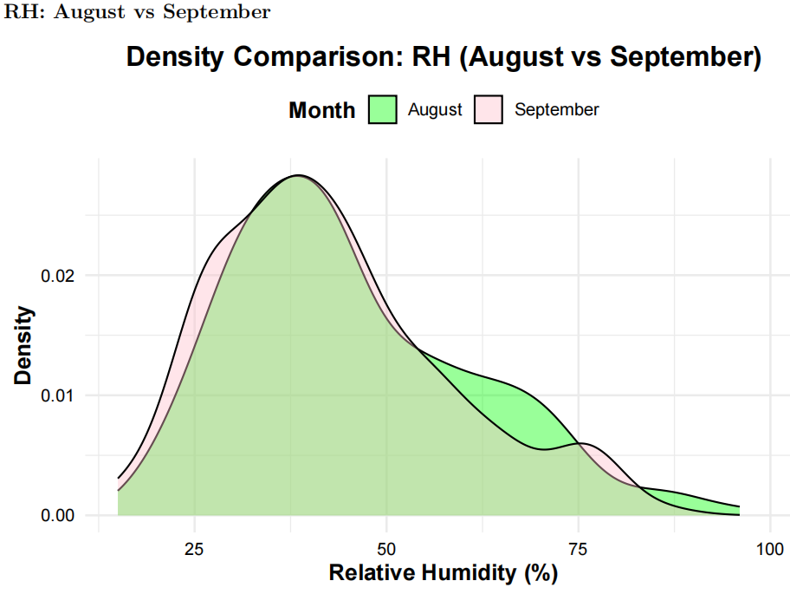
Two-Sample KS Test
Objective: To compares the entire distributions of two samples to assess if they come from the same population. K–S Test detects any distributional difference (shape, spread, skewness, etc.) as well.
Hypothesis for FFMC(Fire vs No Fire):
  H₀: FFMC distributions are identical
  H₁: FFMC distributions differ
Conclusion: FFMC distributions are indistinguishable (p = 0.783); fine fuel moisture alone doesn’t differentiate fire days.
Hypothesis for RH(August vs September):
  H₀: The distribution of relative humidity is identical in August and September
  H₁: The distributions differ
Conclusion: RH patterns remain stable between months (p = 0.325)

Slide 15
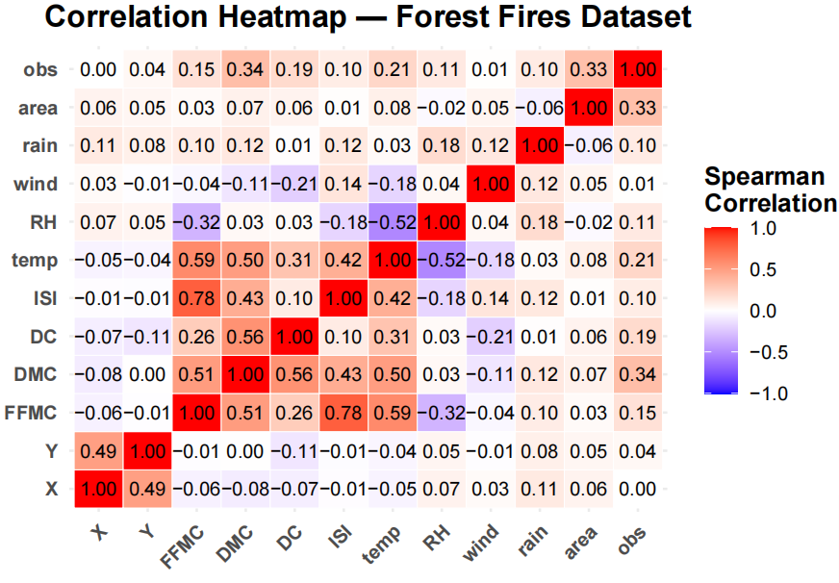
Spearman’s Correlation Test
Objective: To measure the strength and direction of a monotonic relationship between two continuous variables without assuming normality. In the forest fire dataset, it checks if weather variables (FFMC, DMC, DC, ISI, temp, RH, wind, rain) are significantly correlated with the burned area (extent of fire). A non-significant correlation indicates that no single variable independently explains burned area variation; instead, fire behavior is likely influenced by multiple interacting factors.
Hypothesis:
  H₀: No monotonic relationship between weather variables and burned area
  H₁: Significant monotonic relationship exists
Conclusion: All p-values > 0.05 indicate weak monotonic relationships between individual weather indices and burned area extent when fires occur, suggesting complex multivariate interactions govern fire severity

Slide 16
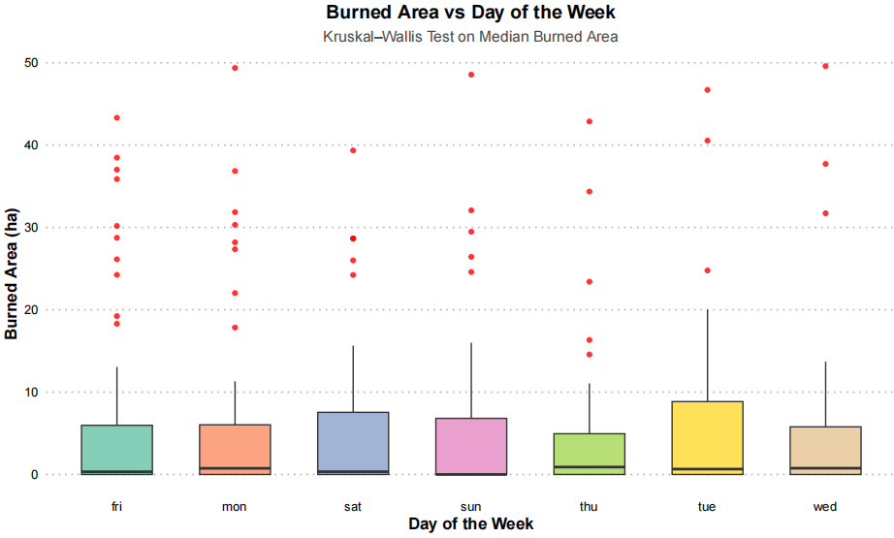
Kruskal-Wallis Test
Objective: The Kruskal-Wallis test is a nonparametric alternative to one-way ANOVA. We want to evaluate whether the median values of a continuous variable differ across more than two groups. In this dataset, it tests if the median burned area varies across days of the week. A non-significant result means fire severity does not depend on the weekday, suggesting that human weekly activity cycles (e.g., workdays vs weekends) do not influence burned area extent.
Hypothesis:
  H₀: Median burnt area is equal across all weekdays
  H₁: At least one weekday has different median burnt area
Conclusion: No significant difference in median burned area across weekdays (p > 0.05), indicating fire severity shows no weekly temporal pattern.

Slide 17

Conclusion & Key Findings
This nonparametric analysis of the Forest Fires dataset reveals critical insights into temporal, meteorological, and environmental factors influencing forest fire occurrence and severity in Montesinho Natural Park, Portugal.
Systematic temporal patterns in temperature, RH, wind, burned area and rain rather than random fluctuations, enabling predictive fire risk forecasting.
Strong seasonal fire risk patterns driven by summer and early autumn climatic conditions.
Temperature and fuel moisture as critical fire risk indicators.
September shows higher DC than August, while August exhibits stronger winds
August shows significantly greater FFMC and ISI variability than September, creating unpredictable ignition and erratic fire spread conditions.
Temperature distribution differs between August and September.
Fire severity is governed by complex multivariate interactions rather than single dominant factors, requiring integrated predictive models.
Fire severity shows no weekly temporal pattern and that natural meteorological cycles dominate over human activity rhythms.

Slide 18
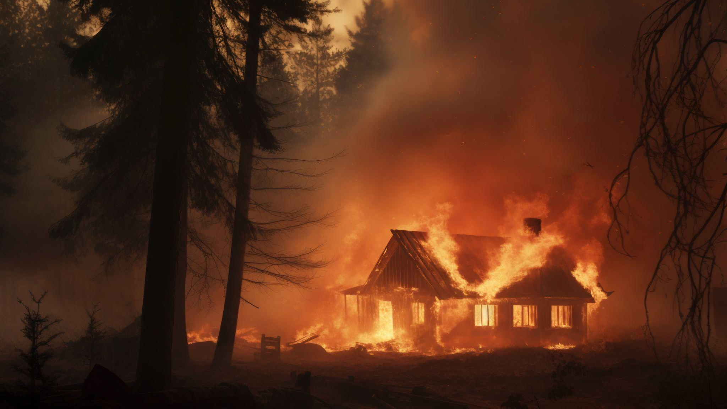
THANK YOU

